Slide 1
ChatRelay
Kenny, Talhah, Zoheb

Slide 2
Classes

Slide 3
Message.java
Represents individual text messages in the chat system
Tracks unique message ID via a static counter
Stores a timestamp at the time of creation, content, sender, and destination chat
Associates messages with both sender and chat room

Slide 4
User.java
+
ABSTRACTUSER.java
Represents an account in the system.
Stores personal data like name, username, password.
Contains unique ID.
Tracks associated chat rooms
Associates users with their conversations.

Slide 5
Chat.java
Represents a conversation room in the messaging system.
Stores a unique ID, room name, and list of chatters.
Supports public and private chat rooms, where privacy affects who can add new members.
Used when creating or loading chat sessions from file.
Chats hold User and Message objects.

Slide 6
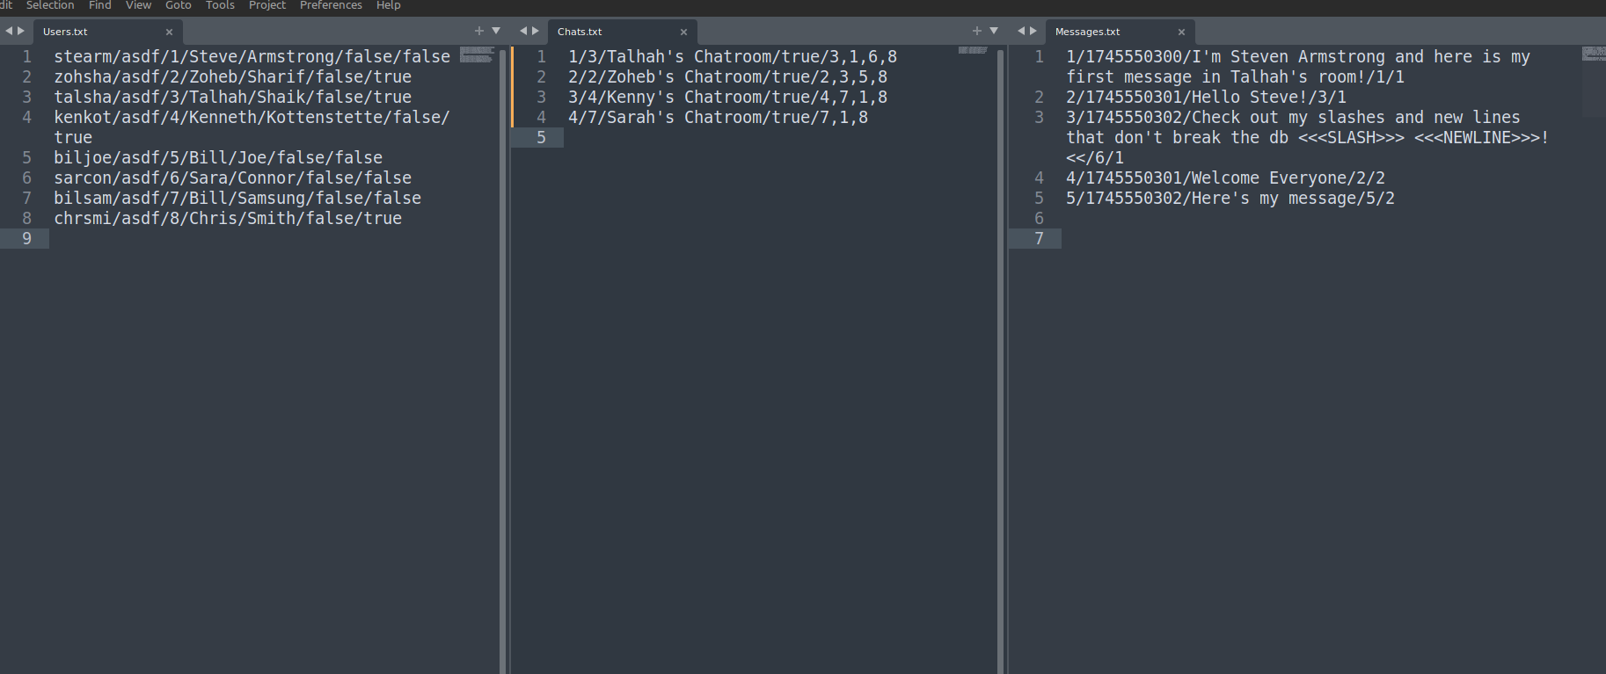
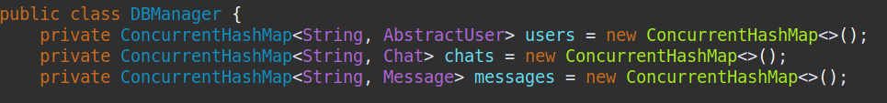
Users.txt, Chats.txt, Messages.txt

Slide 7
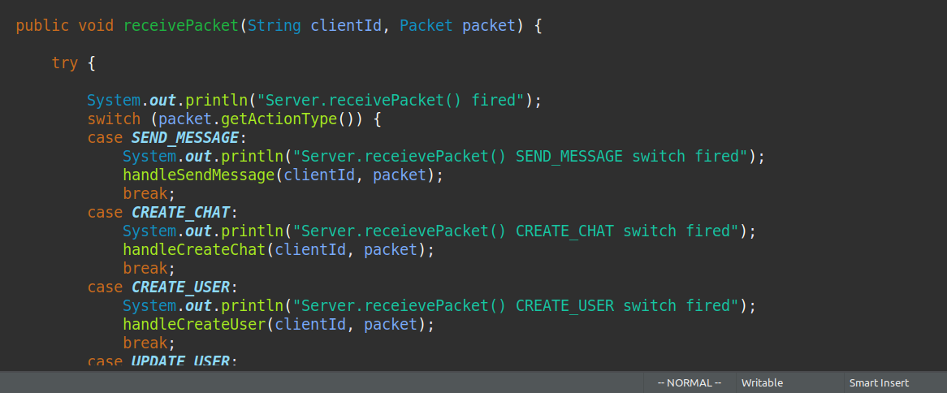
Server.java

Slide 8
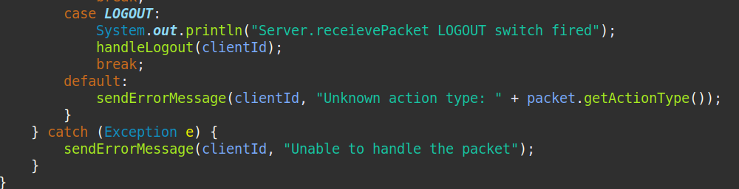
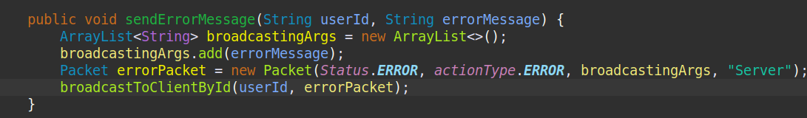
Server.java

Slide 9
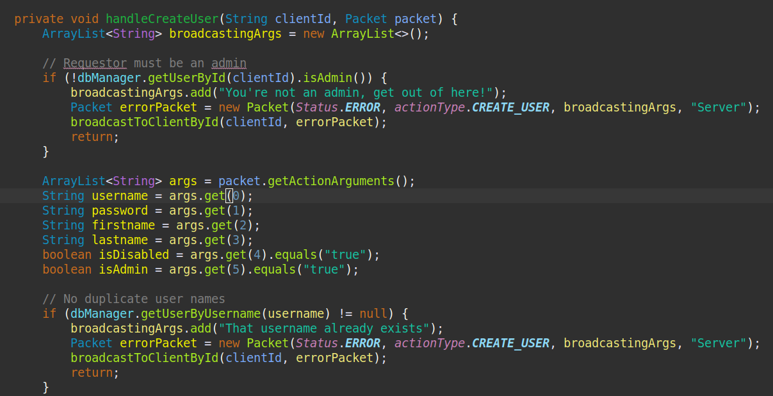
Server.handleCreateUser()

Slide 10
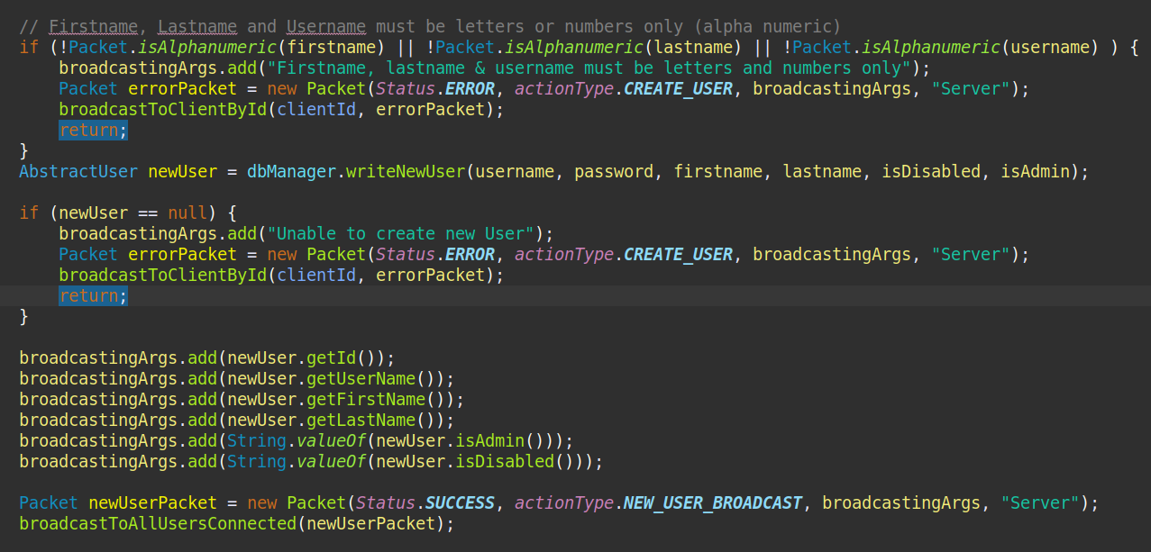
Server.handleCreateUser()

Slide 11
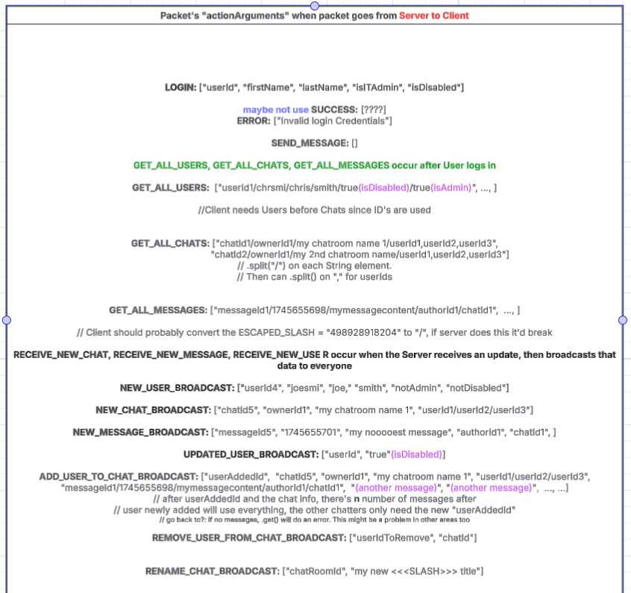
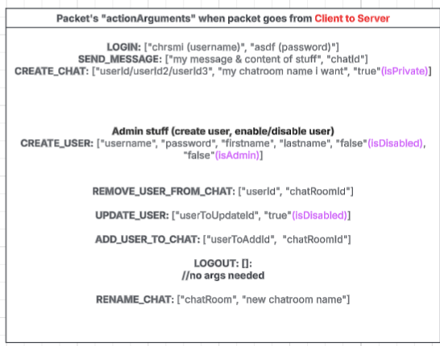
Packet.java

Slide 12
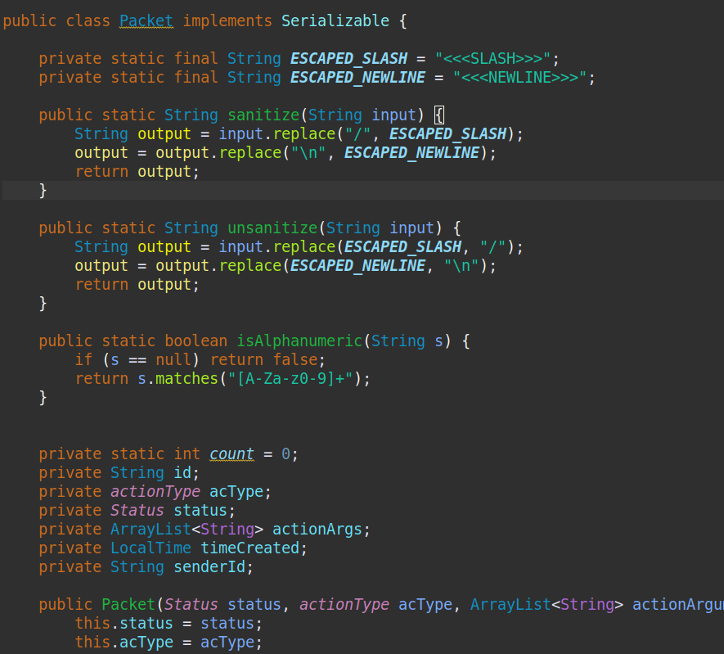
Packet.java

Slide 13
Packet.java

Slide 14
Talhah’s Client/GUI
Stuff goes here
More stuff goes here
Stuff
And stuff

Slide 15
GUI.java / Client.java / whatever
Stuff can go here
Or here

Slide 16
Unit Testing

Slide 17
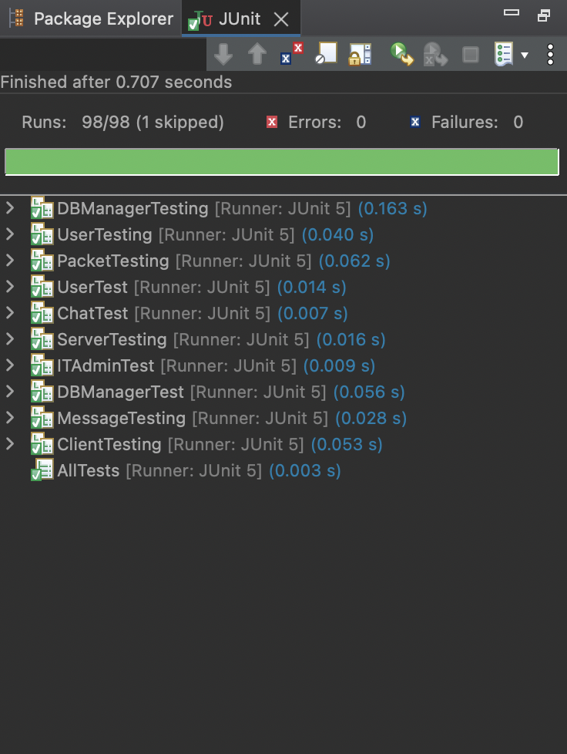
Unit Testing
Uses JUnit framework for automated test execution.
There exists a testing suite in AllTests.java that acts as a driver for all tests in the system.
Covers normal operations, as well as robust operations.

Slide 18
Performed extensive testing for the following classes:
01
02
03
04
05
06
07
08
Chat.java
Client.java
DBManager.java
ITAdmin.java
Message.java
Packet.java
Server.java
ITAdmin.java
* Includes test socket stubs to simulate network connections

Slide 19
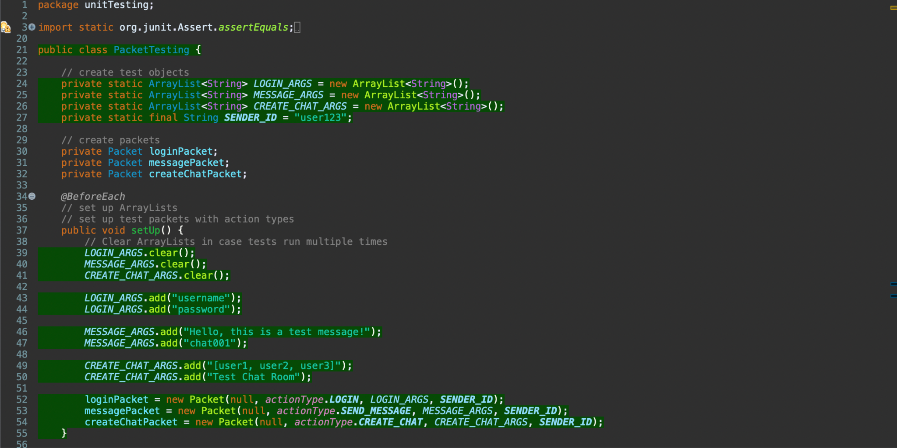
Unit Testing Example

Slide 20
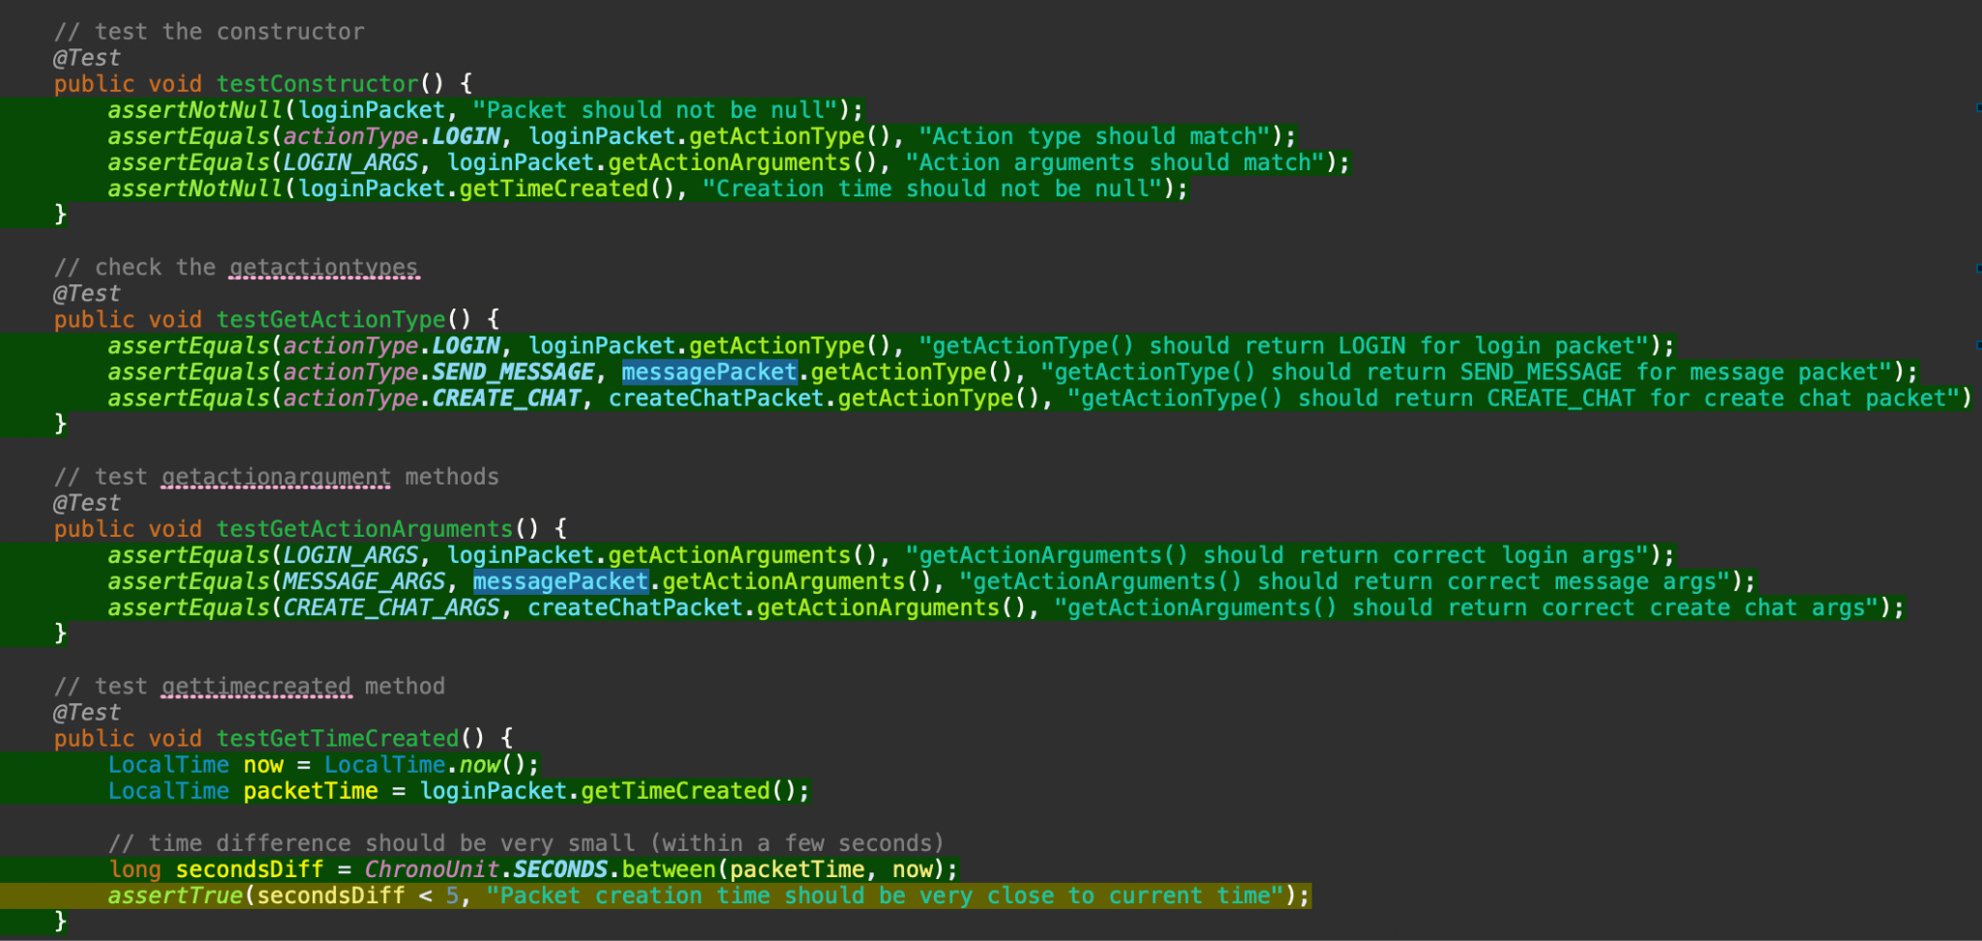
Unit Testing Example

Slide 21
OTHER
Stuff goes here
More stuff goes here
Stuff
And stuff

Slide 22
Demo Time!

